Slide 1
Attachment Theories
The Development of Family and Parent-Child Relationships

Slide 2
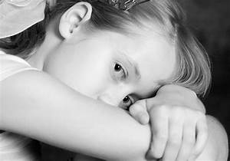
Introduction
Attachment is very important for the growth and development of children.
However, many children are mistreated and abused and this leads to detachment.
Constant mistreatment leads to a disorganized attachment (White, 2018).
It is governed by chronic and intense fear as they relate with parents.
It results from intense traumatic experiences.
Notes:
Children from unstable families are likely to be affected by mistreatments and abuse (White, 2018). Disorganized attachment is governed by threats and fear which is propelled by caregivers and their parents. Traumatic experiences are also major factors as the cause of disorganized attachment hence affecting how children live.

Slide 3
Description of the Child’s Attachment
I studied a child’s attachment who seemed neglected by the parents and noted the following;
The child has many difficulties in controlling his emotions
He usually shows conflicting behaviours most of the time.
He also moves in an unusual way when scared.
Many are the times he is in a state of hyper-vigilance.
The child had a disorganized attachment.
Notes:
According to Crittenden (2017), the disorganized attachment forces children to experience difficulties in controlling emotions. The child conflicts with other children most of the times hence causing fights and violence. In case his parents are not around, he tends to move in an unusual way to show he is scared. This is followed by the child living in an isolated place alone while he avoids interacting with fellow children.

Slide 4
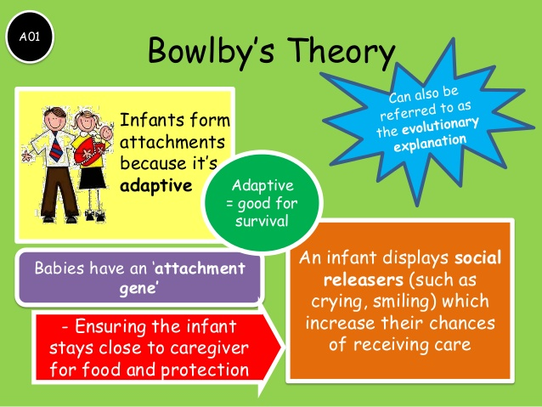
The Child’s Disorganized Attachment and John Bowlby Theory
Children are biologically pre-programmed to form attachments with others (Holmes, 2014).
This is because the attachments enable them to survive.
The child’s environment is not accommodative and supporting.
Parents instil him with fear, trauma and stress.
Notes:
John Bowlby theory asserts that all children are biologically programmed in a way that they are able to form attachments with others (Holmes, 2014). This child’s environment is not accommodative and supporting. For example, there is a lot of violence from adults who keep on fighting and this affects his development. As a result, he is stressed and traumatized since he has fear.

Slide 5

The Child’s Disorganized Attachment and Mary Ainsworth
This emphasizes the importance of parents or guardians care.
The child appears distressed when his mother leaves.
The child react when his mother leaves through crying and looking disturbed (White, 2018).
Reunion behaviours were usually evident after she comes back.
Notes:
Parents care is very fundamental since it influences how children will be brought up (White, 2018). In case his mother is not around, the child becomes distressed hence struggling to adapt the environment. In addition, the child reacts through crying and being angry until her mother is back.

Slide 6
The Child’s Disorganized Attachment and Harry Harlow
It is important for the mother and the child to bond (Crittenden, 2017).
This study also encourages skin-to-skin contact to improve health.
The child do not interact with his mother.
No bond is evident between the two.
Notes:
The bond between the mother and the child is likely to influence how a child will develop (Crittenden, 2017). It is evident that the child’s interaction with his mother is poor and wanting. This can be attributed to be the fault of his mother hence resulting to a poor bond. As such, they do not seem to relate at all meaning the child is likely to live an isolated life.

Slide 7
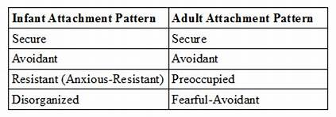
Support of the Theories
I agree with the theories because;
The theories explain the disorganized attachment appropriately.
Parents should understand their children well.
Patterns of attachments are understood well (Holmes, 2014).
Theories can improve the parent-child bond and interactions.
The theories relate well as observed from the child I studied,
Notes:
I think the theories are important in understanding how children develop (Holmes, 2014). Through this, parents are able to understand their children better hence improving how they interact. As a result, they are able to know in case their children have difficulties or not as they develop.

Slide 8
Conclusion
Disorganized attachment is caused by maltreatment from a parents and this was evident from the child I studied.
Parents should be close with their siblings.
Safety for children is important.
A conducive environment counters the disorganized attachment.
Notes:
Disorganized attachment is governed by stress and being traumatized which affects development. This can be solved by parents and caregivers providing safety and giving them love. They should also provide a conducive environment in order to allow their children develop with less difficulties.

Slide 9
References
Crittenden, P. M. (2017). Gifts from Mary Ainsworth and John Bowlby. Clinical child psychology and psychiatry, 22(3), 436-442.
Holmes, J. (2014). John Bowlby and attachment theory. Routledge.
White, K. (2018). Attachment theory and The John Bowlby Memorial Lecture 2013: a short history. In Addictions From an Attachment Perspective (pp. 19-28). Routledge.

Slide 10
Presented by;

